Slide 1


Unsupervised Fundus Surgical Depth Estimation Based on Microscopic Monocular Surgical Videos

Slide 2
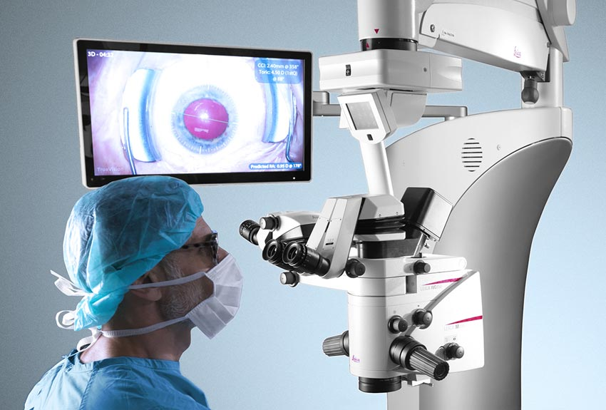

Research Goals
Input：continuous video frame
Output：continuous video frame with depth infomation
Depth = F ( Image )

Slide 3
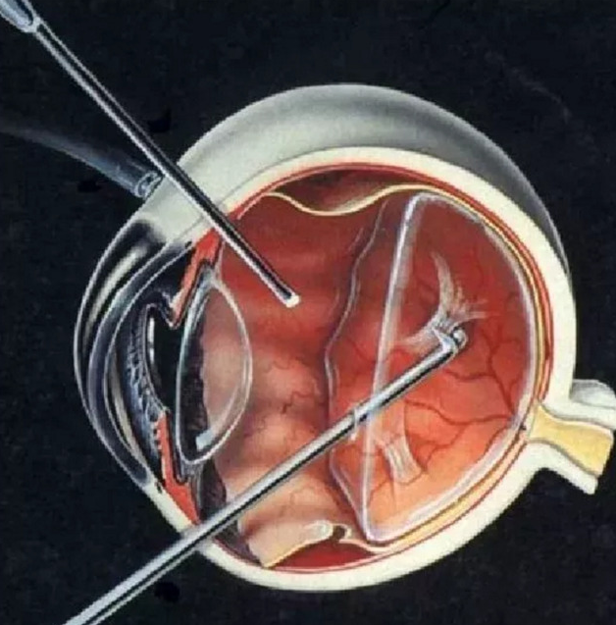
Research Significance
Use: Surgery Navigation, Auxiliary Microsurgery
Limited microscope imaging
obtain the relative depth of the eye to the instrument
Difficulty:
1. Because of the lack of surgery dataset, we need to make our own virtual dataset with depth groundtruth
2, Migration of depth estimation to microscopy scenes

Slide 4
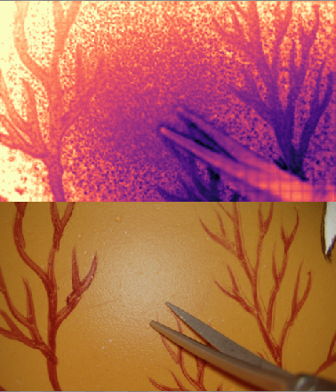
Previous Problems
Lack of quantitative evaluation and over-reliance on visual effects
Cause：Lack of GroundTruth in simulated dataset
Solution：Build virtual dataset with GroundTruth and export correspoinding video
Depth estimation does not work well in some areas
Input data：Uneven light exposure, Grid Effect and blur
Solution：data preprocessing，Modify the loss function
Focus On：The Cause of Grid Effect and the handle method
Grid Effect
Uneven light exposure
Out-of-focus blur

Slide 5
Our Work
Our work
Virtual Dataset
Export of virtual video
Export of Ground Truth of the video
evaluation based on virtual dataset
Method
（To handle the Grid effect）
Depth in the wild
Preprocessing the input data
Defocus Deblur
Modify the Loss Function
Weighted SSIM → SSIM
Build the frontend presentation window

Slide 6

2.1 Virtual Dataset

Slide 7
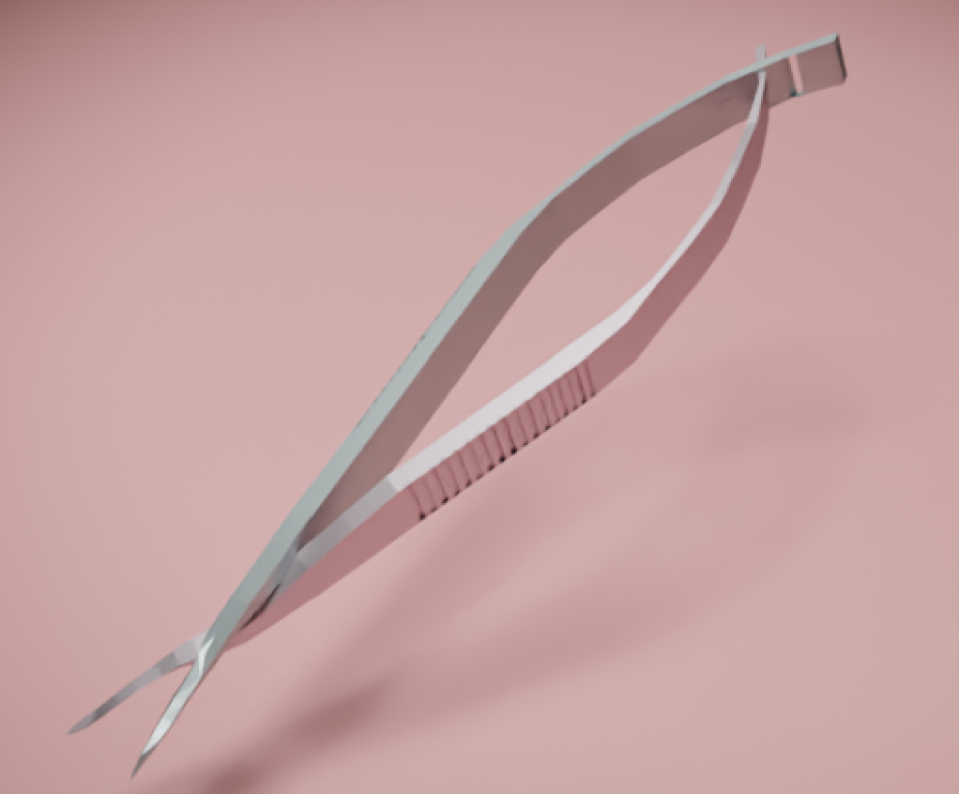
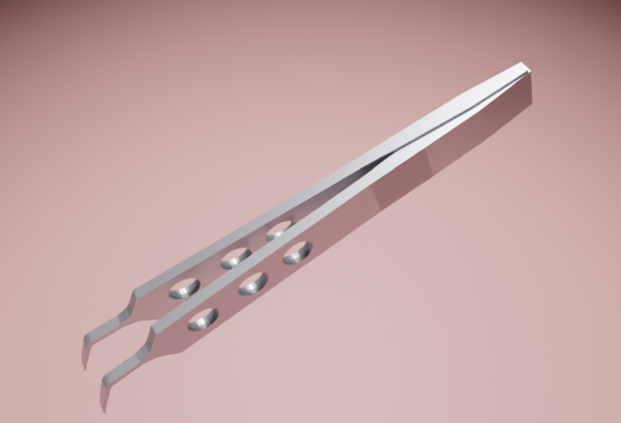
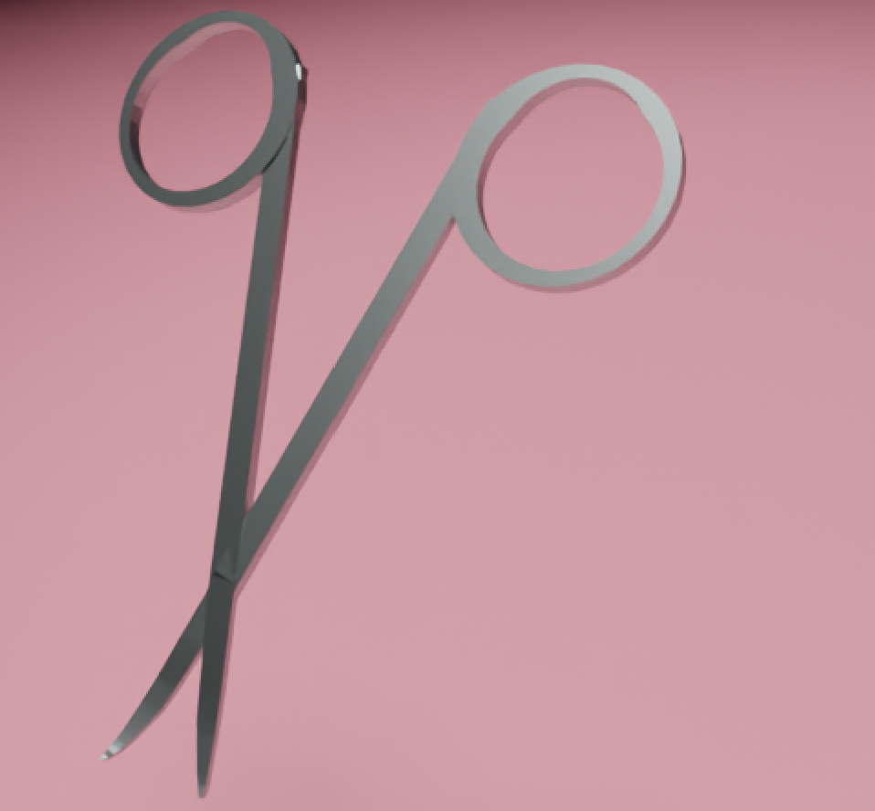

Improving tasks of Modeling the Virtual Data
Corneal Scissors Straight Scissors Ophthalmic Forceps Ophthalmic Scissors
Notes:
上学期我们已经使用 blender 建立了种类较为齐全且精度较高的虚拟数据集，这个数据集可以作为我们无监督实验的 Ground Truth

Slide 8
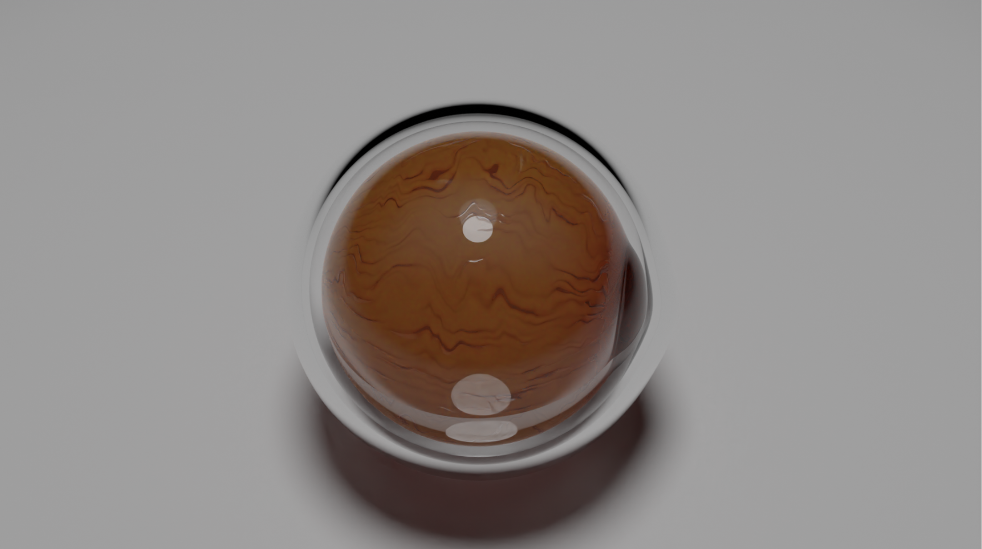
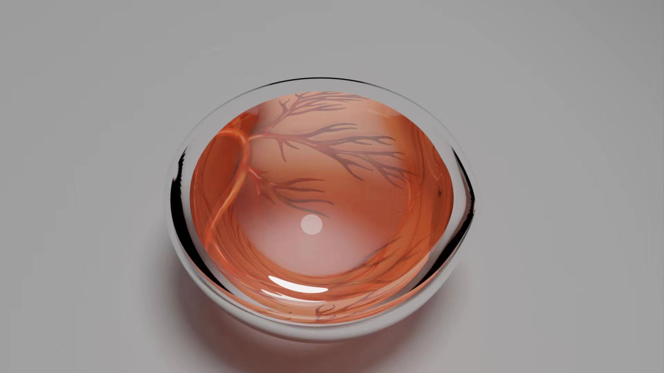
Improving tasks of Modeling the Virtual Data
eyeball background
fundus of the eye background

Slide 9


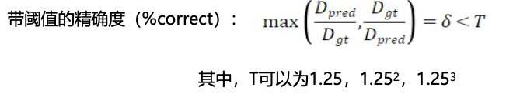
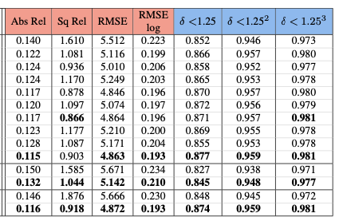
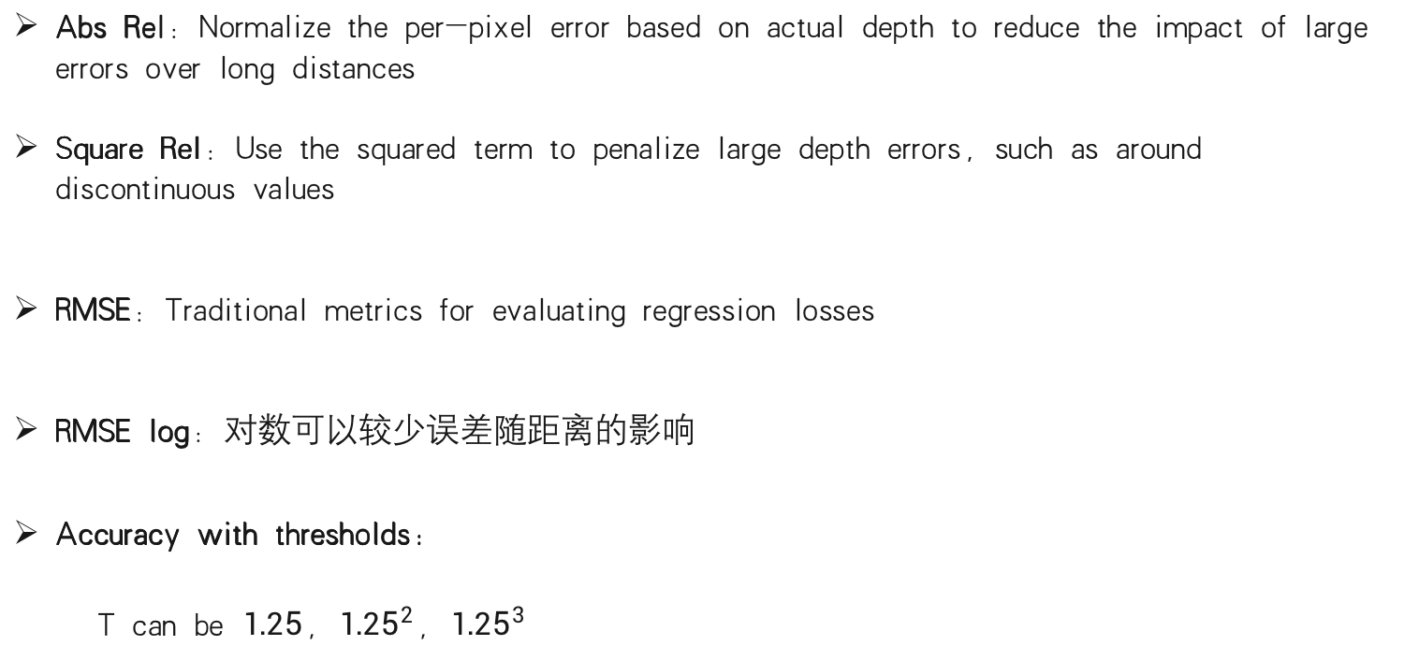
Quantitative Evaluation on Virtual Dataset
Abs Rel：Normalize the per-pixel error based on actual depth to reduce the impact of large errors over long distances
Square Rel：Use the squared term to penalize large depth errors, such as around discontinuous values
RMSE：Traditional metrics for evaluating regression losses
RMSE log：对数可以较少误差随距离的影响
Accuracy with thresholds:
T can be $1.25，{1.25}^{2}，{1.25}^{3}$
The metrics used in Monodepth2

Slide 10
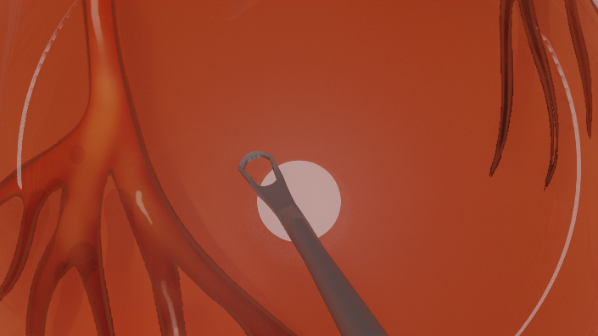
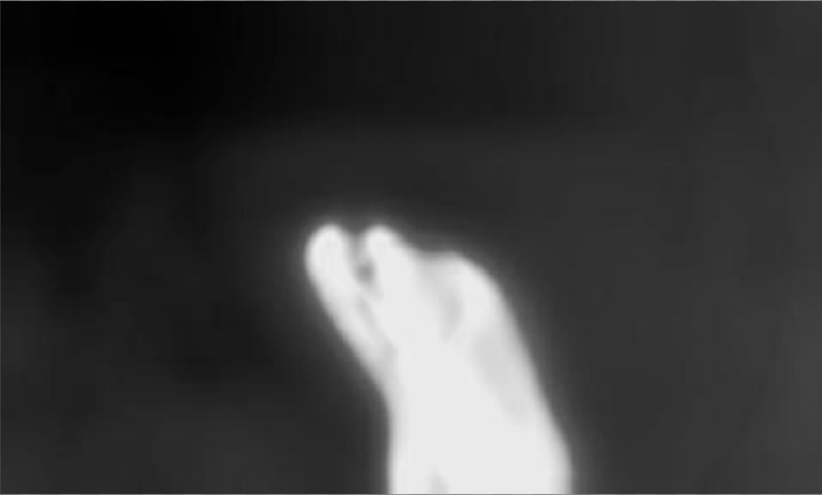
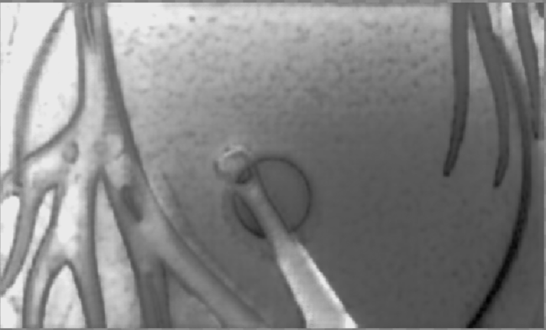
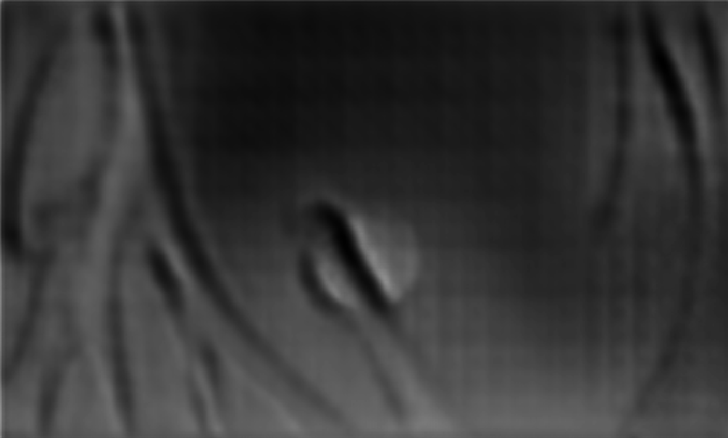

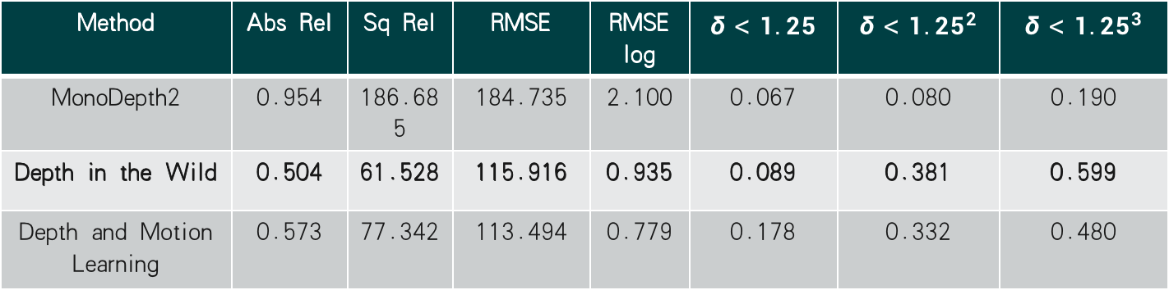
Quantitative Evaluation on Virtual Dataset
raw
Monodepth2
Depth in the wild
Depth and motion learning
Method | Abs Rel | Sq Rel | RMSE | RMSE log | $$δ<1.25$$ | $$δ<{1.25}^{2}$$ | $$δ<{1.25}^{3}$$
MonoDepth2 | 0.954 | 186.685 | 184.735 | 2.100 | 0.067 | 0.080 | 0.190
Depth in the Wild | 0.504 | 61.528 | 115.916 | 0.935 | 0.089 | 0.381 | 0.599
Depth and Motion Learning | 0.573 | 77.342 | 113.494 | 0.779 | 0.178 | 0.332 | 0.480
ground truth

Slide 11
2.2 Depth in the Wild
Gordon, A., Li, H., Jonschkowski, R., & Angelova, A. (2019). Depth from videos in the wild: Unsupervised monocular depth learning from unknown cameras

Slide 12
Previous Results
The darker the color, the further away from the lens and the greater the depth
Main Problems:
Uneven illumination has a significant effect on the predicted depth map
The input image has a grid effect at the out-of-focus blur
The background blood vessel part brings obvious errors
Direction
Data Preprocessing：Defocus Deblur
Modify the loss function：Weighted-SSIM → SSIM
Depth in the Wild

Slide 13
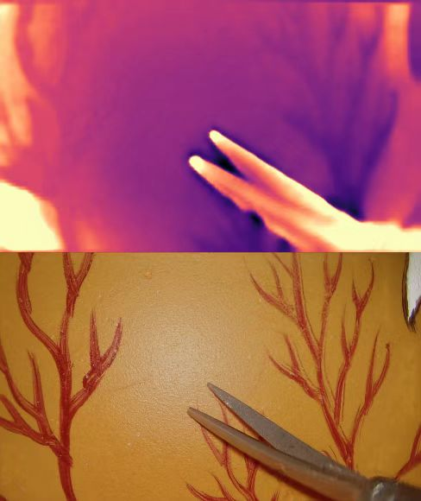
Data Pre-Process: Defocus Deblur
Control the variable
dataset：4000+images
Iteration：50epoch
Comparison in Visual effect
After Deblur, the background is significantly smootherNo Grid Effect
However, the edge extraction and depth estimation of the surgical instrument part are not fine enough
Before
After

Slide 14
Data Pre-Process: Defocus Deblur
Analysis
Deblur is helpful for depth estimation and can at least help with grid effects
But we should first make sure that the quality of images has improves
From the figure Deblur makes the background part clearer, while for the instrument part although not out of focus blurred, but the image noise has increased
Before
After

Slide 15
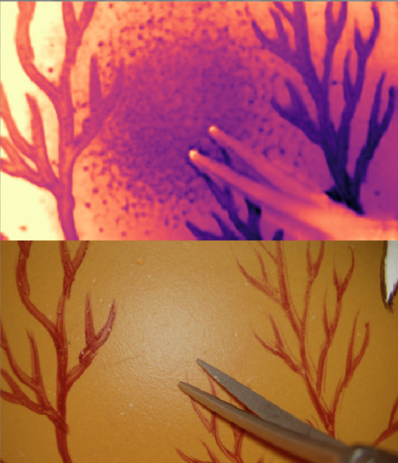
Try Modifying Loss Functions
Weighted SSIM Loss → SSIM Loss
The former chunked the images, used sliding windows and found the SSIM of each window before averaging;
The latter finds the mean, variance and covariance of the whole image to calculate SSIM
Grid effects in depth maps can be solved using SSIM
Using Weighted-SSIM provides a more effective supervised signal and better overall depth estimation
Before
After

Slide 16
Try Modifying Loss Functions
Causes of grid: weighted SSIM + out-of-focus blur
Follow-up research ideas
Considering the overall effect of depth estimation, it is still advisable to keep Weighted SSIM and solve the mesh problem from the perspective of deblurring
Detect the fuzzy region in the network, then reduce the weight of Weighted SSIM Loss calculation of this fuzzy region, and keep the other parts unchanged
Before
After

Slide 17
2.3 The Frontend Interface

Slide 18
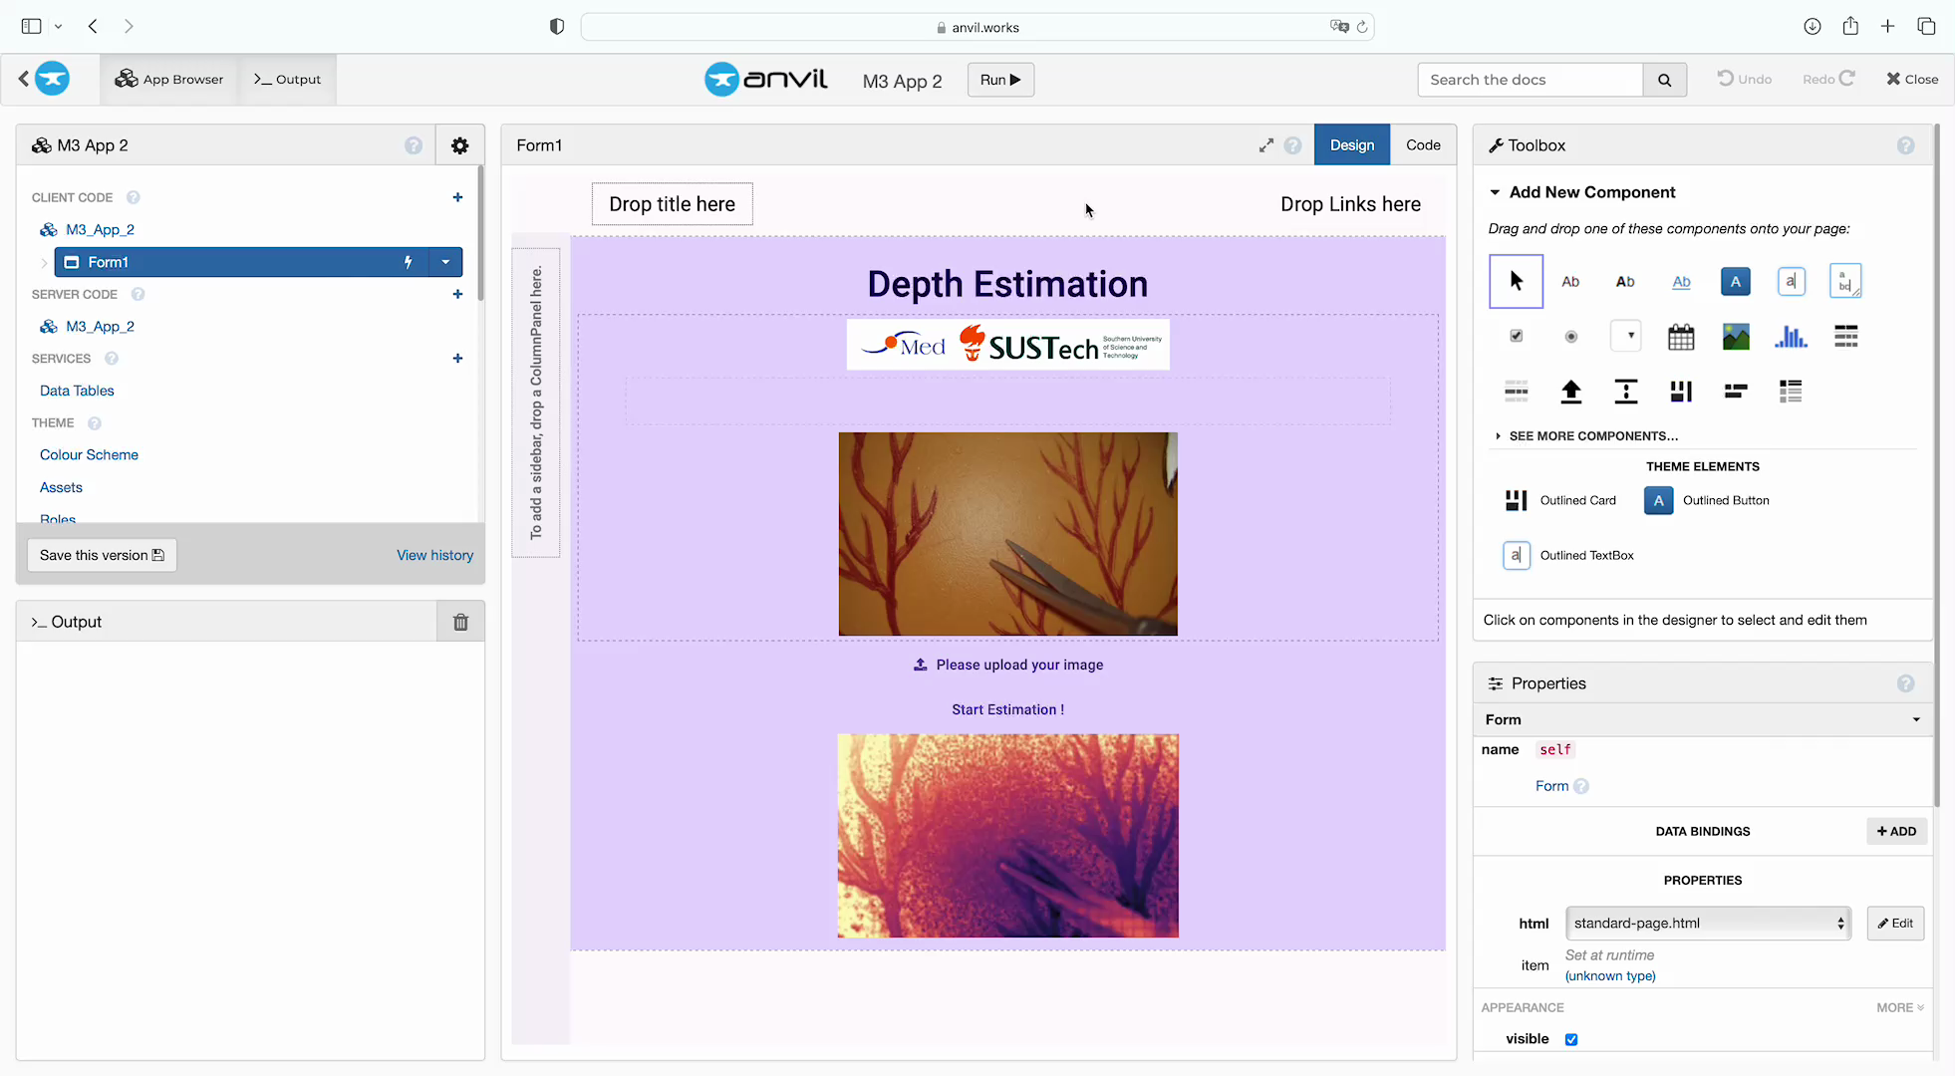
Front-end Interactive Platform Show

